Slide 1





DTU’s ECOSYSTEM

Slide 2
The ecosystems aim is to expand the knowledge base of students by showing that their academic education can be transformed into solutions for existing problems in the world.

Slide 3




Slide 4


Slide 5






Who are we?
Best Student-driven Initiative
for Entrepreneurship of Denmark in 2015
Student-run organisation
Fostering a
startup community
Promoting
entrepreneurship
Our partners
Notes:
- help you meet entrepreneurs and like-minded students
- help you network and connect
help you start up
: You discover entrepreneurship first, then it’s your time to act to find an idea and a team and finally you launch your company! We are here to help you with all those steps

Slide 6

What we do
DemoDay
Events and Workshops
Focused on
specific topics
Discover entrepreneurship,
get inspired!
From an idea to
your company

Slide 7
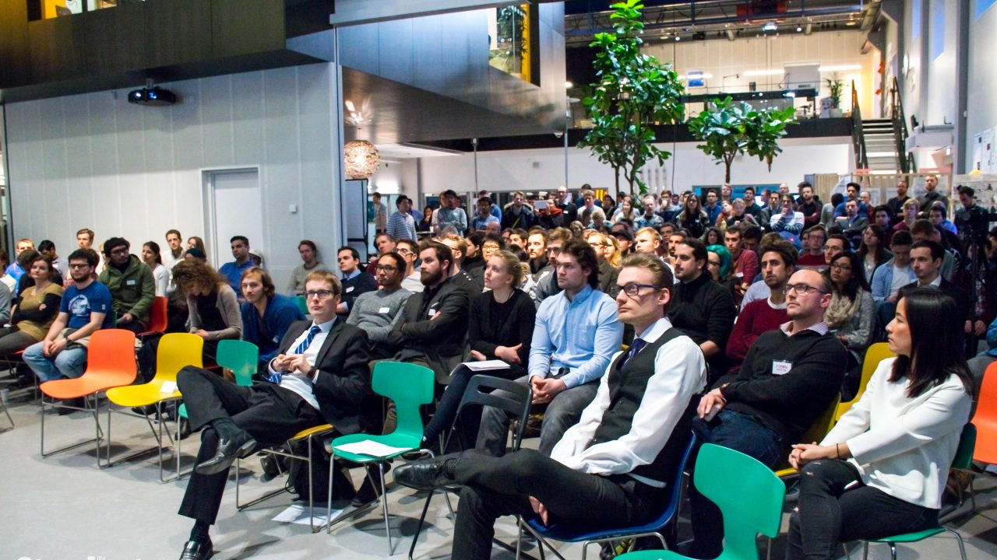

DTU Startups
Pitches & Competition
1
2
3
4
5
Free food and beers
Q&A Session
Inspiring Talks
With successful entrepeneurs and mentors
Networking
With dozens of startups and partnersi.
Notes:
Gather professional and students
Meeting likeminded people

Slide 8




Idea
Company
One semester
100% FREE
Notes:
Early stage incubator
Connect this workshop

Slide 9
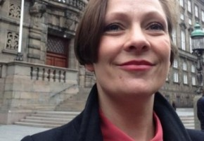
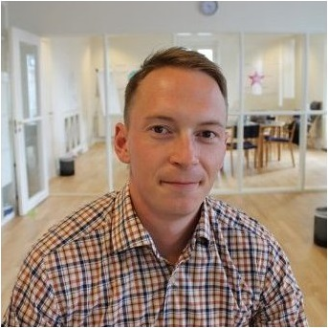
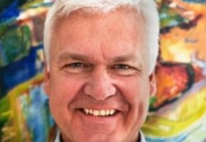
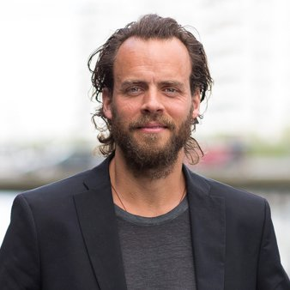
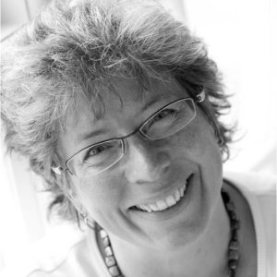
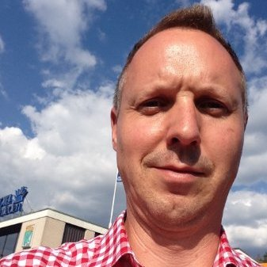
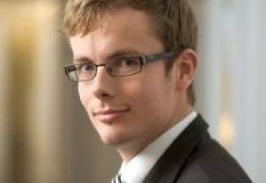

Mentors and Mentor Board
Internal advisory board composed of mentors with all the necessary expertise for Startups in addition to individual mentors for each startups by leveraging our extensive mentor network to provide comprehensive advice and critical thinking for the startups

Slide 10

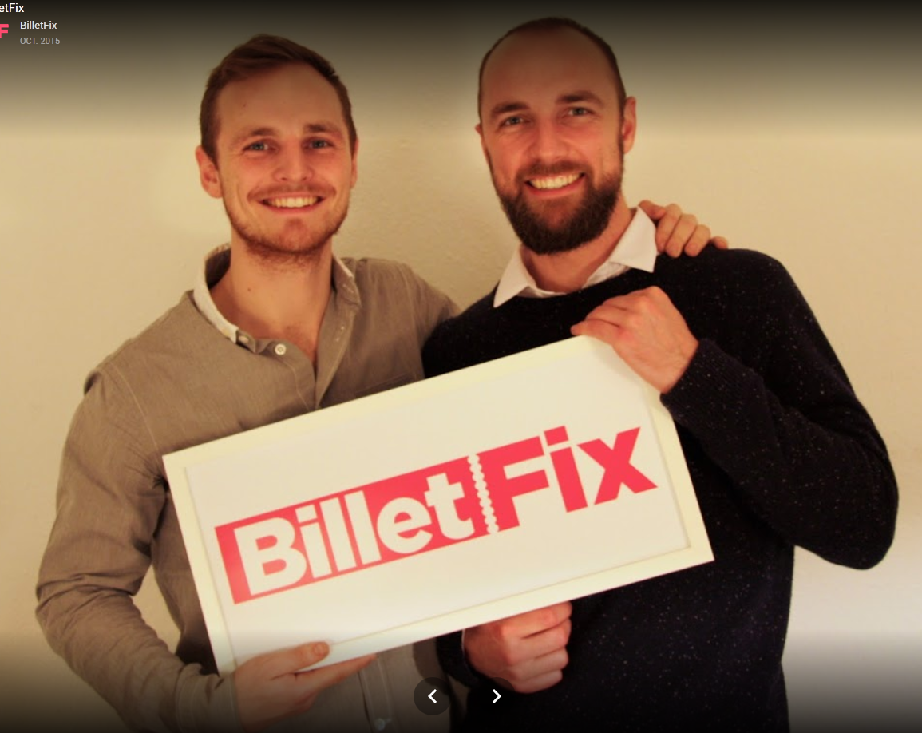
Startup Program & its success stories
Simple ticketing system
3K tickets sold
Expanding in Australia
In the Program in 2015

Slide 11


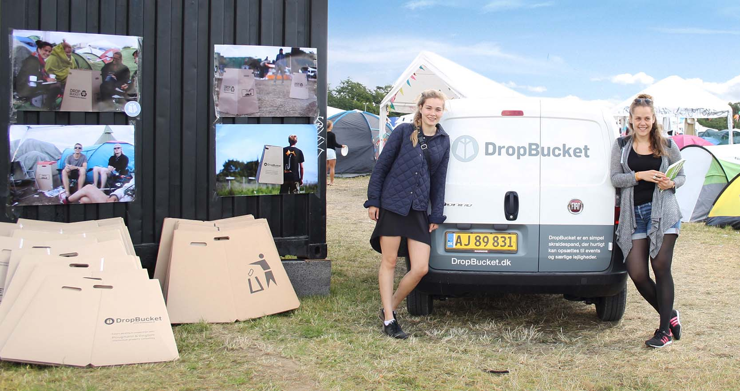
Startup Program & its success stories
Sustainable bins for events and festivals
+20 festivals adopted it
Expanding abroad
In the Program in 2014

Slide 12
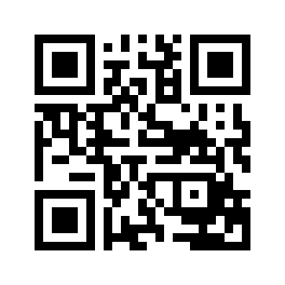
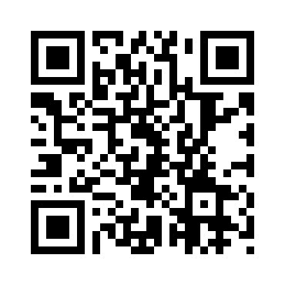



Contact Us
www.stardust-dtu.dk
www.facebook.com/DTUstardust
@StardustDTU

Slide 13

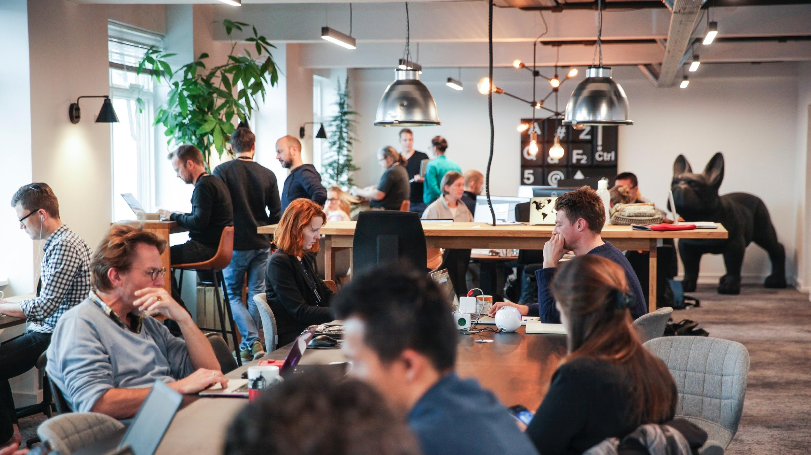

Presentation at DTU 10/09/2018
Notes:
Who are we: <include from KAJE presentation>

Slide 14
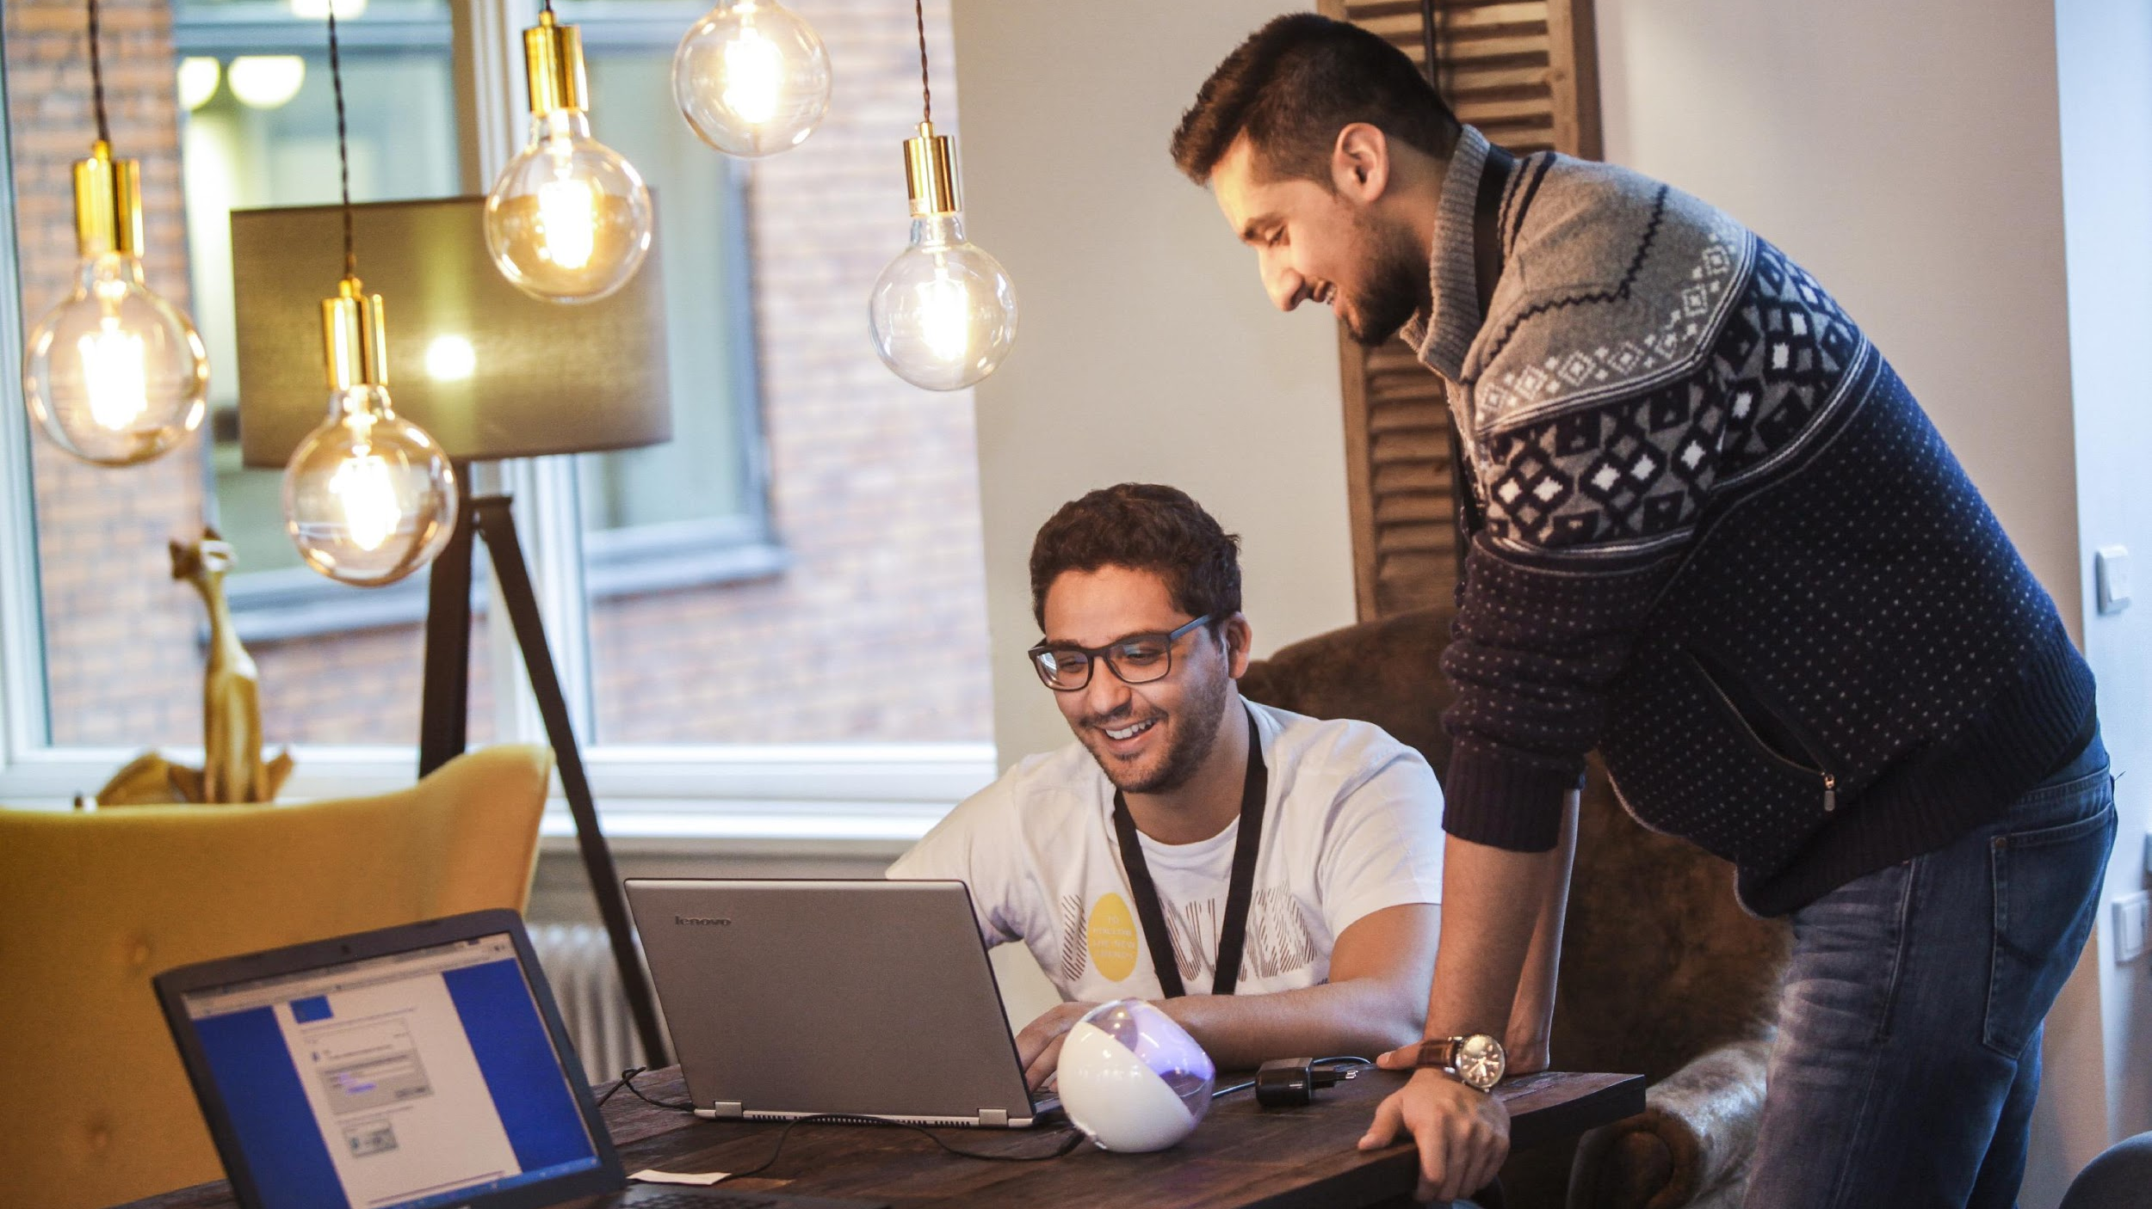
VENTURE CUP OFFERS
Startup Competitions
Training
Mentoring
Networking
Notes:
What venture cup offers.
-2 national start up competitions and 1 international competition annually.
-Training (Pitch training, include from KAJE presentation)
-Mentoring: Largest mentor program in Scandinavian with more than 300 mentors ready to help.
-Platform for networking (at competitions, events, training sessions ect.)

Slide 15

Introducing the National Competitions
Notes:
The following slides introduces our competitions.

Slide 16

REQUIREMENTS
Hand in Business Plan
Apply on venturecup.dk
Remember the deadline
Note the specific requirements of each competition
t
NOTE THAT
Members of the jury, mentors, and Venture Cup staff have all signed a Non-Disclosure Agreement (NDA).
Notes:
Format of submission:
Hand in your business plan
Follow instruction on our webpage
Remember the deadline. YOU CAN INPUT DEADLINE DATE HERE IF GIVEN and delete bullet 4.
Members of the jury, mentors and Venture Cup Staff will all have signed an NDA

Slide 17

WHY PARTICIPATE?
Cash prizes
Feedback on business plan
Networking
Get training
Meet experts
Notes:
Rewards 2 / 2
Again win cash prizes.
Get vital feedback on your business plan from jury professionals. Every participant is guaranteed feedback!
Meet serial entrepreneurs, investors, researchers and industry experts.
Training in pitching, prototyping, networking and write a business plan.

Slide 18
A BIT ABOUT RULEs
Idea must be your own
Are you working with a patent that is not yours?
Explain it, e.g. licensing rights
You can submit more than one idea.
You can participate again
If your business idea has been considerably developed since you last participated
Notes:
Rules:
The idea submitted must be the team's own idea
If the team is working with a patent that is not there own, they must be able to explain this, e.g. they have licensing rights ect.
It is possible to submit more than one idea.

Slide 19
Questions about the competitions?
CONTACT
Simon Ringive
University Manager
E: Siri@venturecup.dk
Kathrine Jerl Jensen
University Manager
E: Kaje@venturecup.dk
Or visit venturecup.dk

Slide 20






Connecting business professionals
with university startups
Since 2014
Go to: http://venturecup.dk/mentor/
Notes:
Introducing the mentor program
Provide a litte ekstra tekst here if relevant for the presenter.

Slide 21
Launched February 2014
Diverse industries and skills
More than 350 startup and mentor matches
89 % of startups came closer to the market
0.70 paid full time position created pr. match
97 % would recommend the program to other startups
Go to: http://venturecup.dk/mentor/
Notes:
Introducing the mentor program
Provide a litte ekstra tekst here if relevant for the presenter.

Slide 22
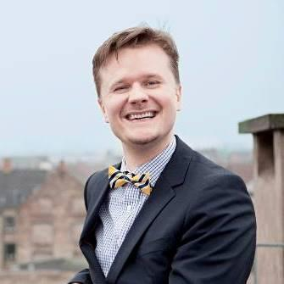
Scandinavia's largest
MENTOR PROGRAM
For University Startups
Alex Steninge Jakobsen
One of our 400 high-profile mentors
Been mentoring since 2017
Is now a board member and investor in the startup (Harba) he has mentored
Is driven to “pay it forward” and help startups grow their business
Notes:
Introducing the mentor program

Slide 23
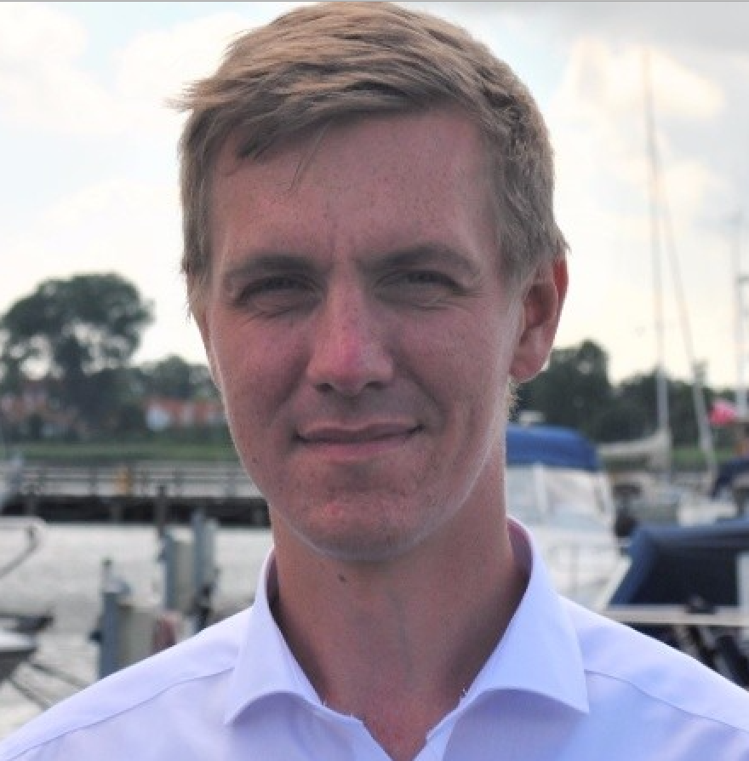

Scandinavia's largest
MENTOR PROGRAM
For University Startups
Christian Elkrog / Harba
Won a VC category in 2016
Joined the program in 2017
A mentee who now has become a mentor
Has accelerated his business
Recommends everybody to join the program
Notes:
Introducing the mentor program

Slide 24
How to join?
Contact Project Manager
Keyvan Bamdej
Mail: keyb@venturecup.dk
Phone: +45 2684 8666
Or go to: http://venturecup.dk/mentor/
Notes:
Introducing the mentor program
Provide a litte ekstra tekst here if relevant for the presenter.

Slide 25
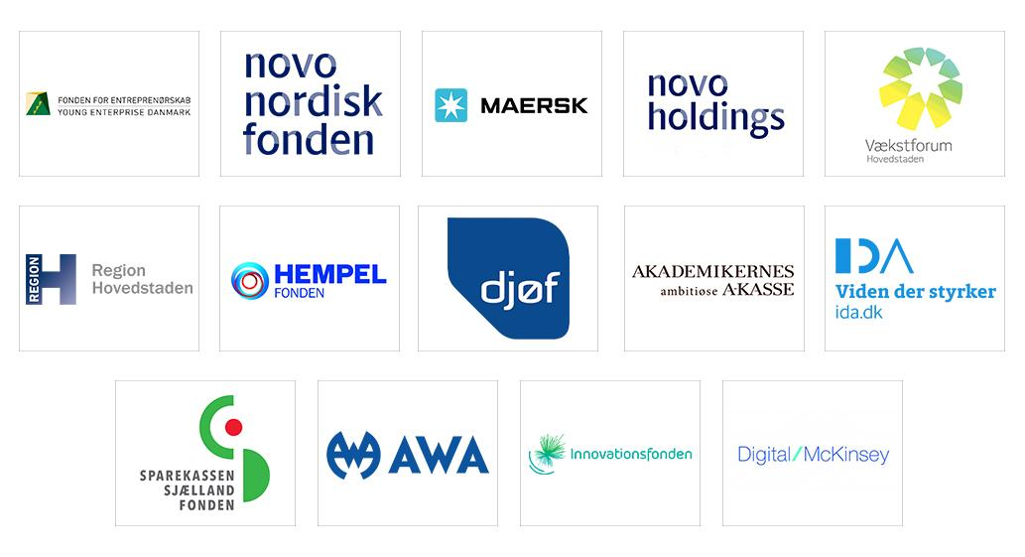
Thanks to our Sponsors
Notes:
Please give thanks to our sponsors

Slide 26

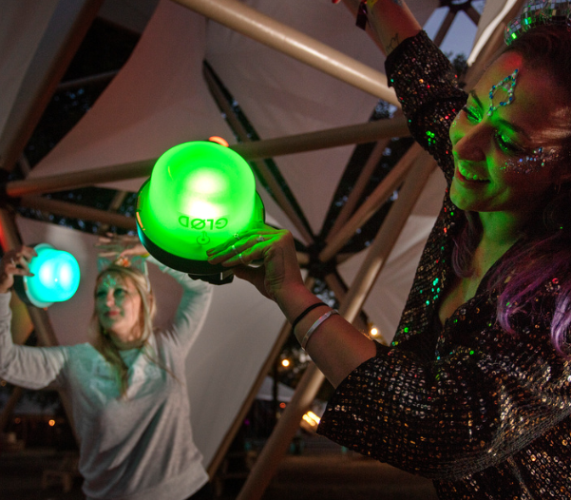
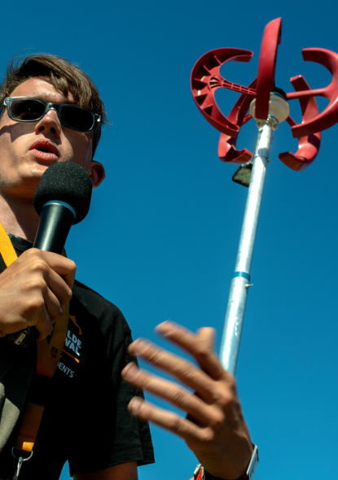
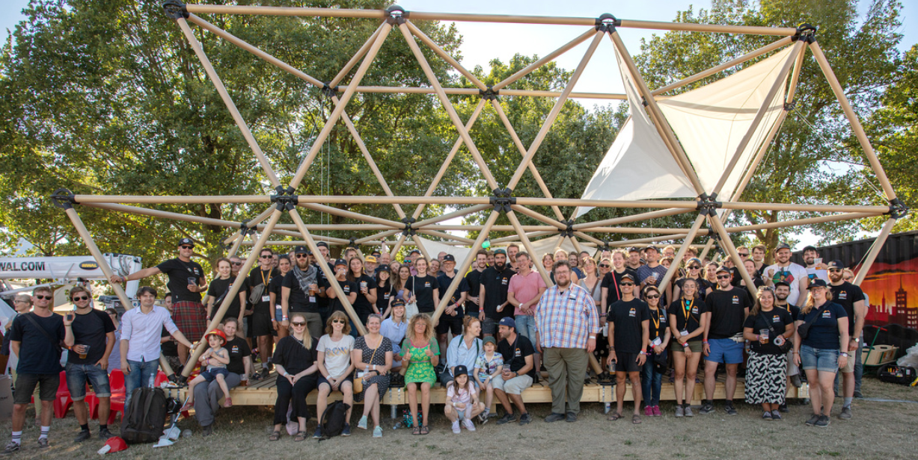
Notes:
Welcome, my name is.. im from..

Slide 27
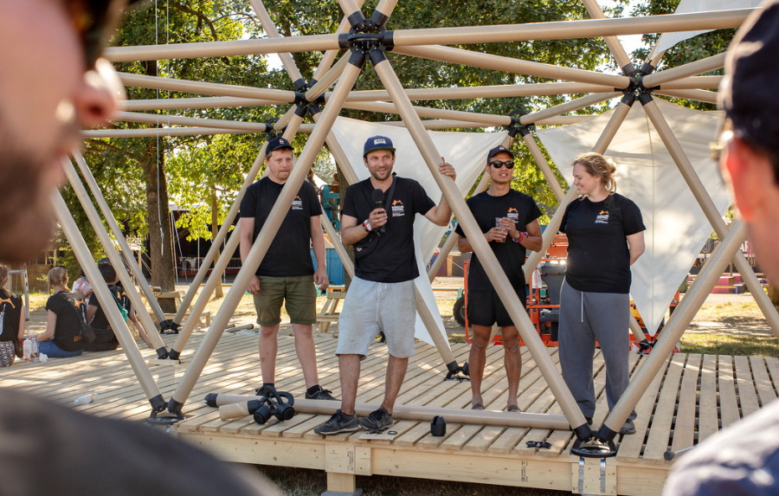
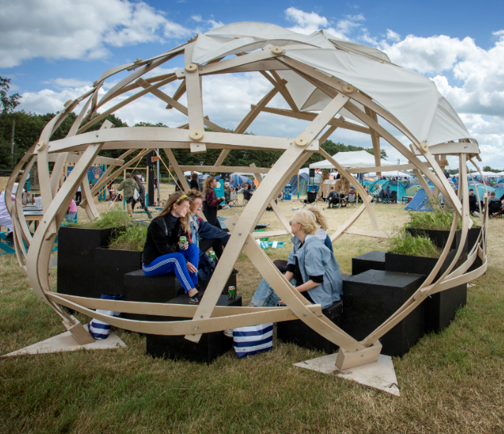
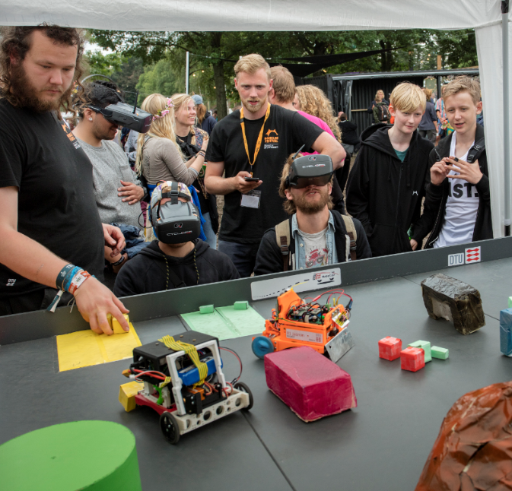
About the collaboration
100 students
Students work with technical problems for the festival
Solutions to real world problems
A playground for students, a test platform
Notes:
Daniel

Slide 28
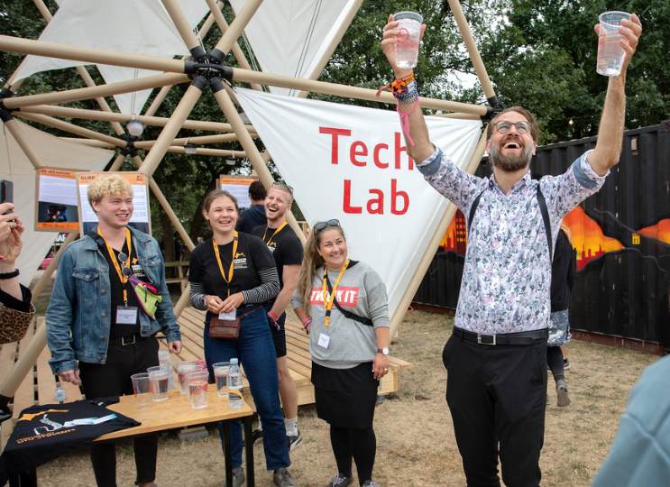
Who and how?
All DTU students can participate
You get ECTS credits for your project
Free access to the Festival
Notes:
Daniel

Slide 29
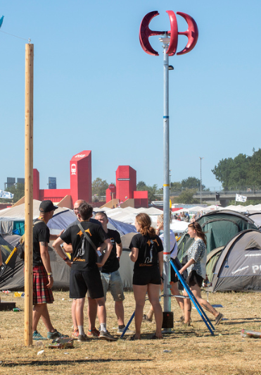
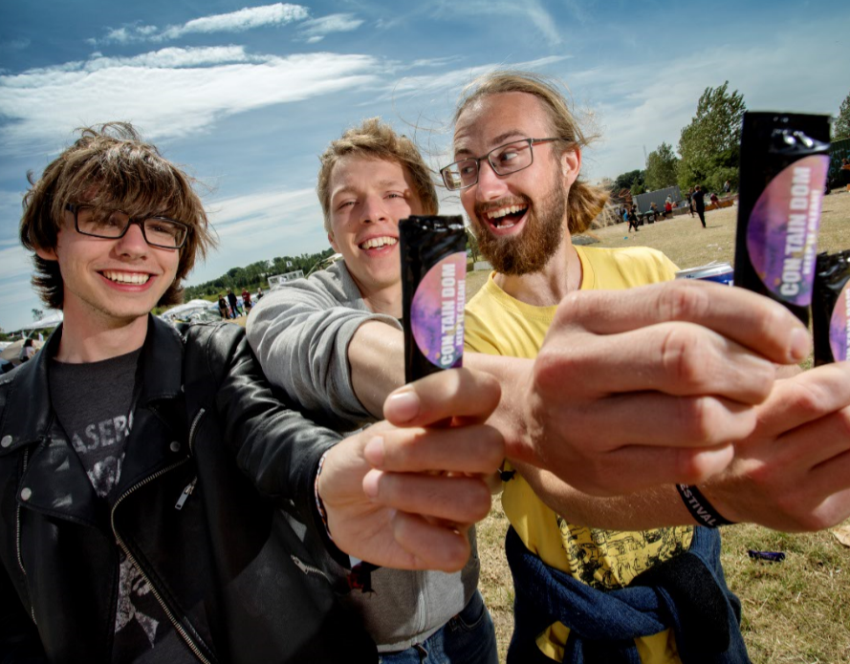
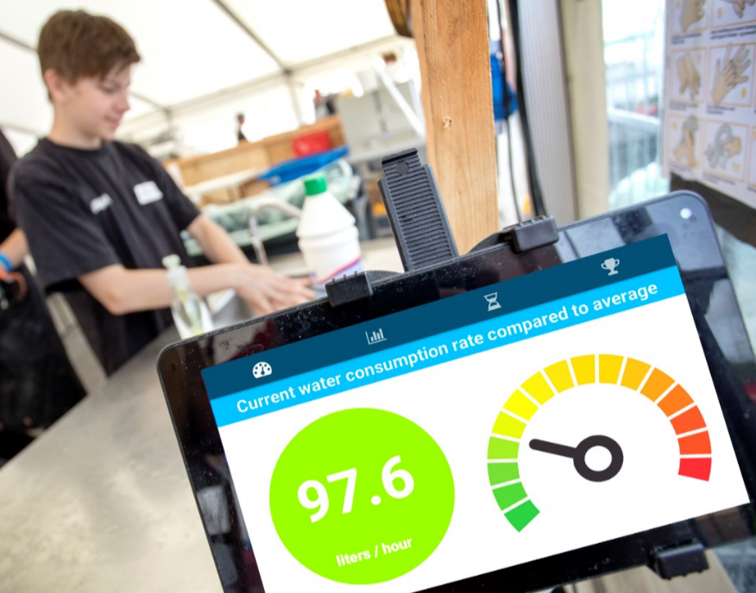
How to participate?
From the course database
Waste management
Acoustics conditions
Special course (3 week period in June)
Roskilde festival project as a case in another course
Techlab Crew
Notes:
Daniel, Bare lige opliste hvordan man kan være med.

Slide 30
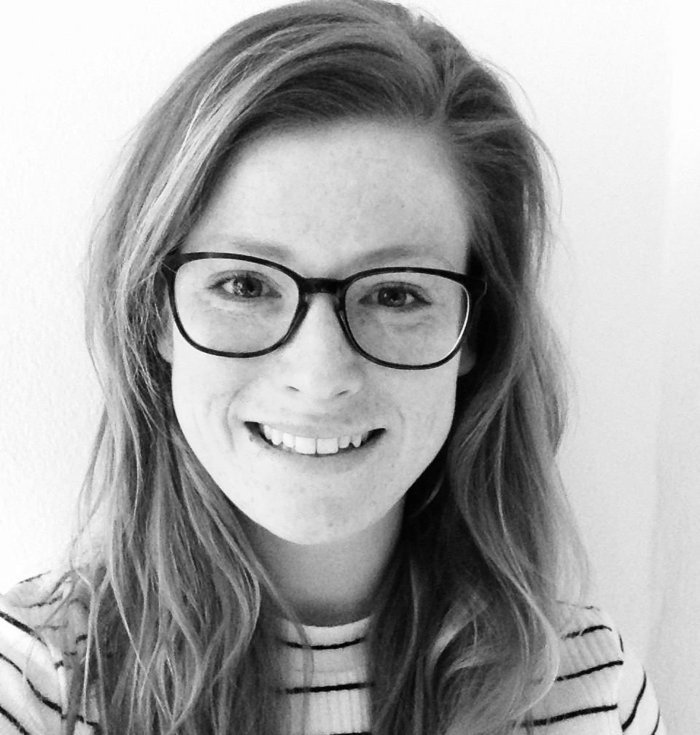

Contact
Kathrine Nissen
kanis@adm.dtu.dk
Notes:
Kathrine

Slide 31
Cliamte-KIC

Slide 32



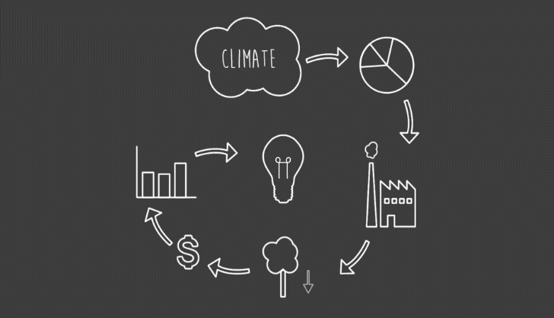
Climate-KIC Journey: Summer school
5 week climate innovation summer school travelling around Europe
Climate change knowledge combined with entrepreneurship skill
Wide range of backgrounds
Find solutions to climate change
Online application January 2019: www.climate-kic.org/programmes/education/

Slide 33
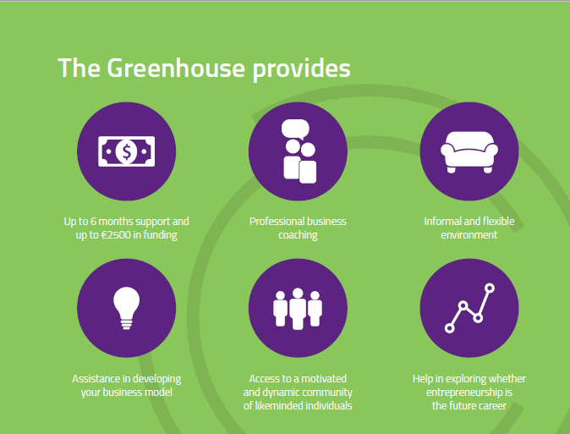
Greenhouse: Pre-incubator
Take your idea one step further in 6 months!
01 Oct – 11 Nov: Applications open via website!
12 Nov – 3 Dec: Assessment by local teams, incl. interviews
By 6 Dec: Successful teams informed
Jan 2019: Kick-off!
Jan - July: Programme phase with coaching, workshops, etc.
Aug: Wrap-up phase (report, survey etc.)
Local chapter: www.greenhouse.climate-kic.org
Contact, Julia: greenhouse@climate-kic.org

Slide 34
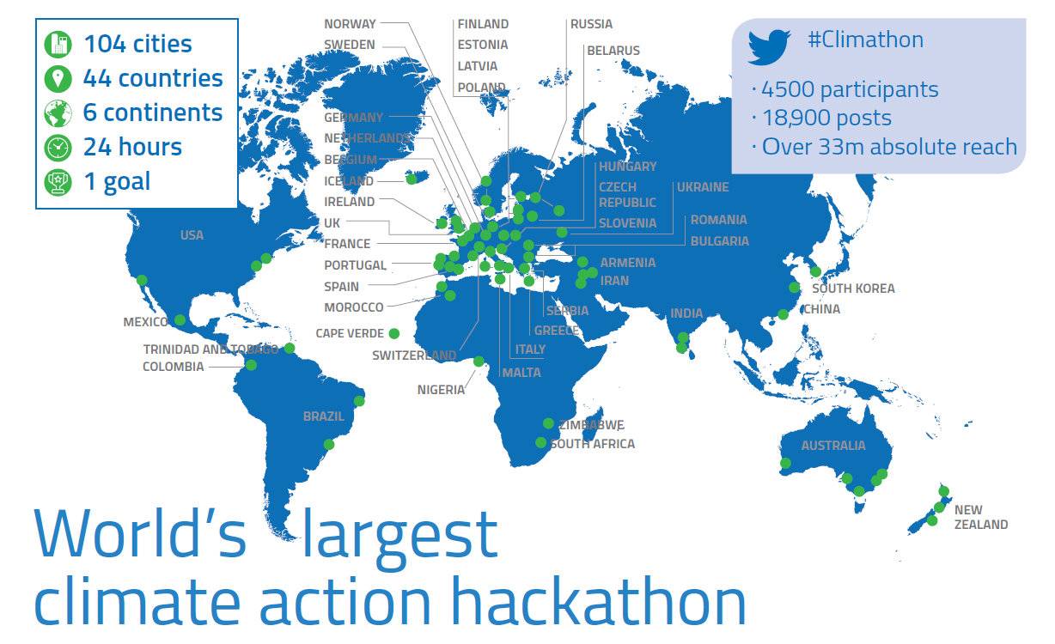
Climathon: 26 October 2018

